Slide 1



Driver Drowsiness Detection System
ERODE SENGUTHAR ENGINEERING COLLEGE
( An Autonomous Institution)
Perundurai, Erode – 638 057.
Department Of Computer Science And Engineering
Guided by
Ms. S. Sivaselvi,AP/CSE
Presented by
DHARANI R [ES19CS13]
KAVENESH N [ES19CS36]
NANDHAKUMAR S [ES19CS44]

Slide 2
ABSTRACT
Drowsiness detection is a safety technology that can prevent accidents that are caused by drivers who fell asleep while driving.
The main aim is to build a drowsiness detection system is that alerts the driver whenever he/she feels drowsy
The eye movement of the driver is monitored live and whenever the driver feels asleep or closes eye for more than few seconds then it alerts the driver with the help of alarm sound

Slide 3
OBJECTIVES
This system can be used to reduce the amount of road accidents that happens to great extent.
The main motive of this system is that it can save a lot of lives.

Slide 4
REQUIREMENTS
Python - 2.7 or 3.9 Version
OpenCV - Face and Eye Detection
Keras - To build our classification model Convolutional Neural Networks(CNN)
TensorFlow - Keras uses Tensorflow as backend
Pygame - To play alarm sound

Slide 5
WORKING PROCEDURES
Step 1 – Take image as input from a camera.
Step 2 – Detect the face in the image and create a Region of Interest (ROI).
Step 3 – Detect the eyes from ROI and feed it to the classifier.
Step 4 – Classifier will categorize whether eyes are open or closed.
Step 5 – Calculate score to check whether the person is drowsy.

Slide 6
Block Diagram
Input Image
Pre-processing
ROI
Eye detection
Drowsiness Alert
Recognisation
Tracking
Creating Bounding
box

Slide 7
MODULES
Data Collection for Eye Images
Face and Eyes Detection
Model training
Classification

Slide 8
Data Collection for Eye Images
The data comprises around 1435 images of people’s eyes under different lighting conditions.
We separated them into their respective labels ‘Open’ or ‘Closed’

Slide 9
FACE AND EYE DETECTION
FACE DETECTION
This module takes input from the camera and tries to detect a face in the video input.
The detection of the face is achieved through the Haar classifiers.
EYE DETECTION
Since the model works on building a detection system for drowsiness we need to focus on the eyes to detect drowsiness.
The eyes are detected through the video input by implementing a haar classifier namely Haar Cascade Eye Classifier.
The eyes are detected in rectangular formats

Slide 10
MODEL TRAINING
Built our classification model by training on the dataset
Iterating over each image and get the image in array form
After training the model on our dataset. The model architecture file “models/cnnCat2.h5”
which was trained on convolutional neural networks.

Slide 11
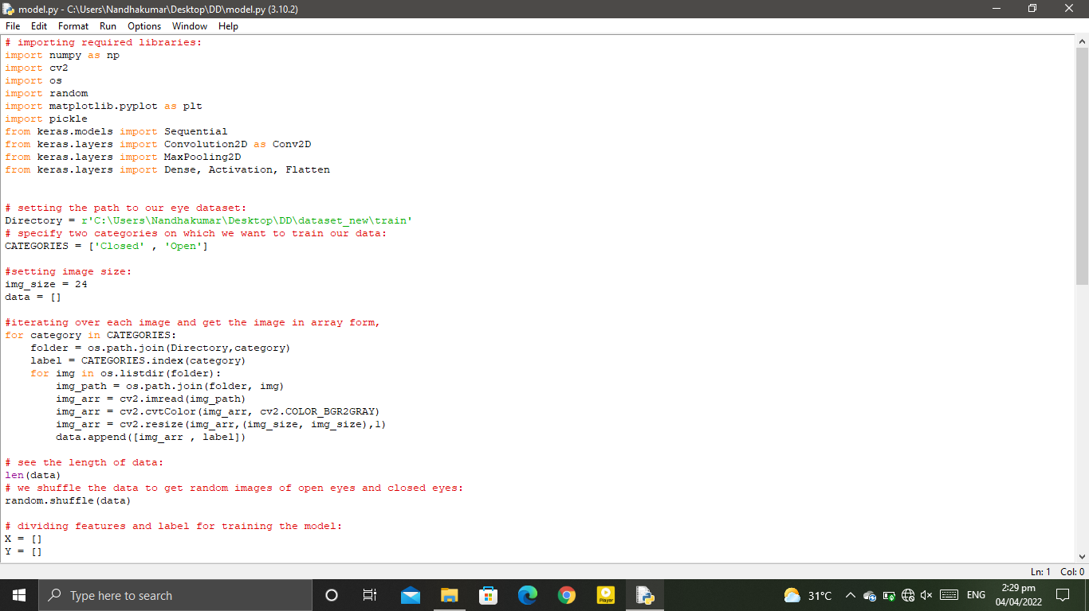
Sample Coding

Slide 12
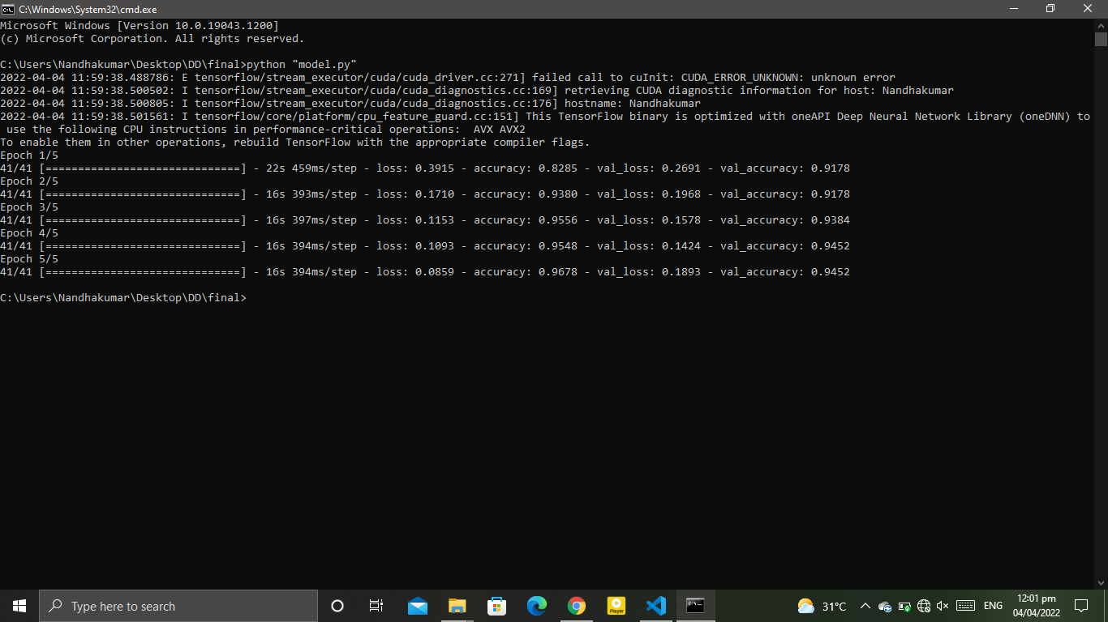
Output of the Model build

Slide 13
References
Kaushish, V., Singh, N., Maggo, K., Nagrath, P., & Jain, R. (2021). Driver drowsiness detection system with opencv and keras. SSRN Electronic Journal.
Vandna Saini, Rekha Saini “Driver Drowsiness Detection System and Techniques”, IJCSIT, Vol. 5 (3), 2014.
Mitharwal Surendra Singh L., Ajgar Bhavana G., Shinde Pooja S., Maske Ashish M. “Eye Tracking Based Driver Drowsiness Monitoring & Warning System”, IJTRA, Volume 3, Issue 3, May-June 2015.

Slide 14
THANK YOU

